Slide 1
Building the mogul course
Matevž Stanovnik, 2011

Slide 2
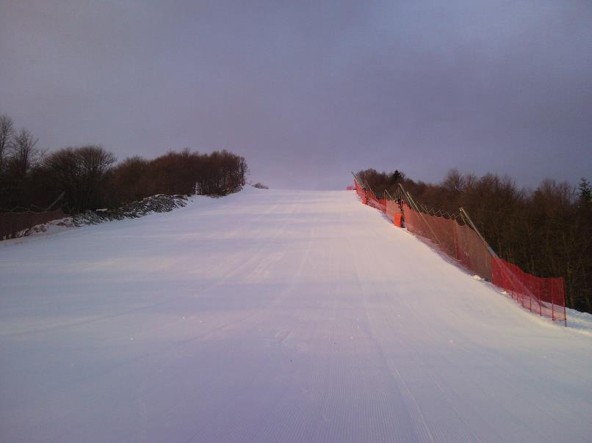
Marking the terrain

Slide 3
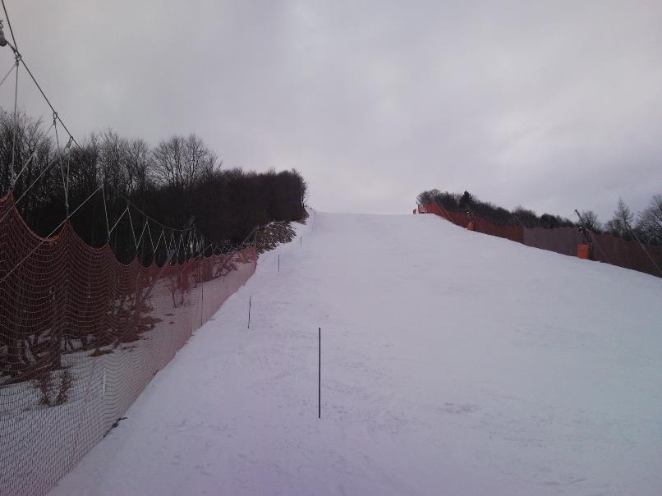
Marking the terrain

Slide 4
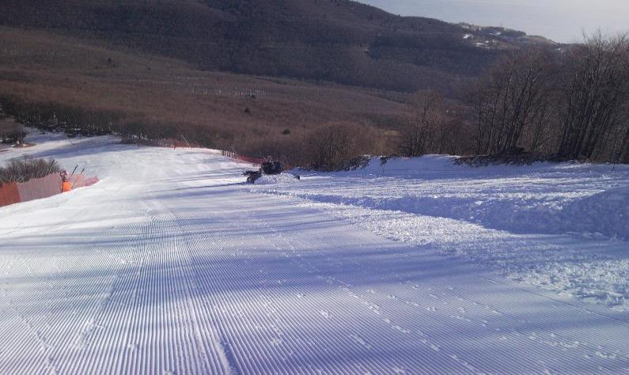
The course should not be tilted to one side or the other

Slide 5
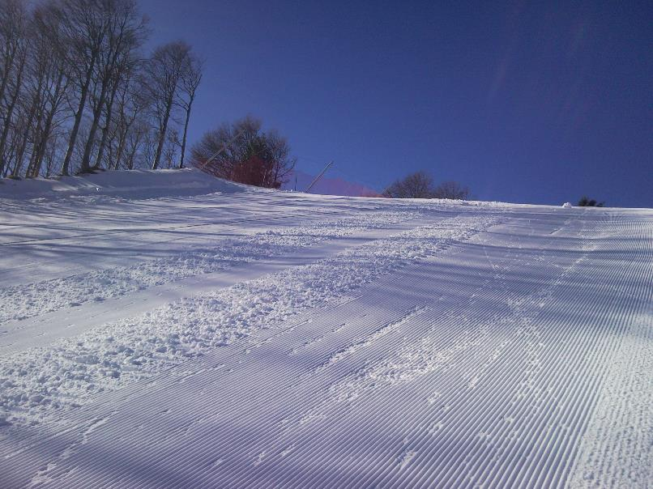
…so level it up

Slide 6
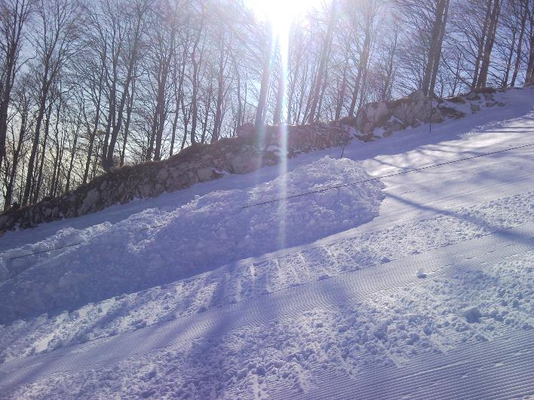
Making the tables for the two Airs

Slide 7
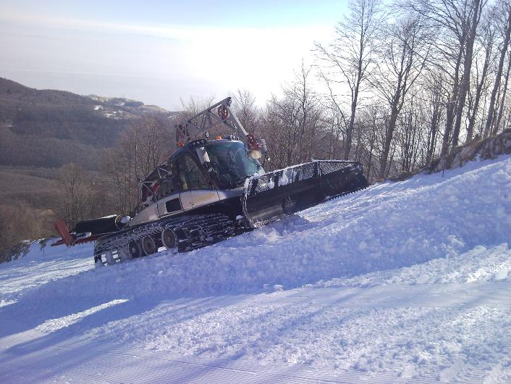
Making the tables for the two Airs

Slide 8
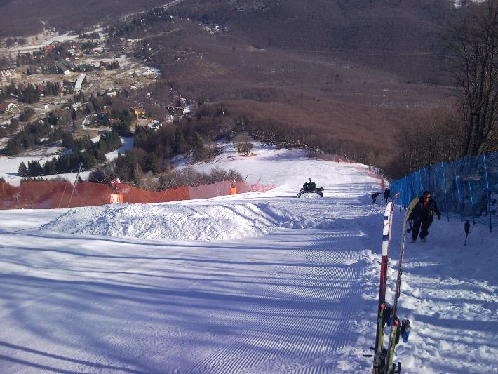
Making the tables for the two Airs

Slide 9
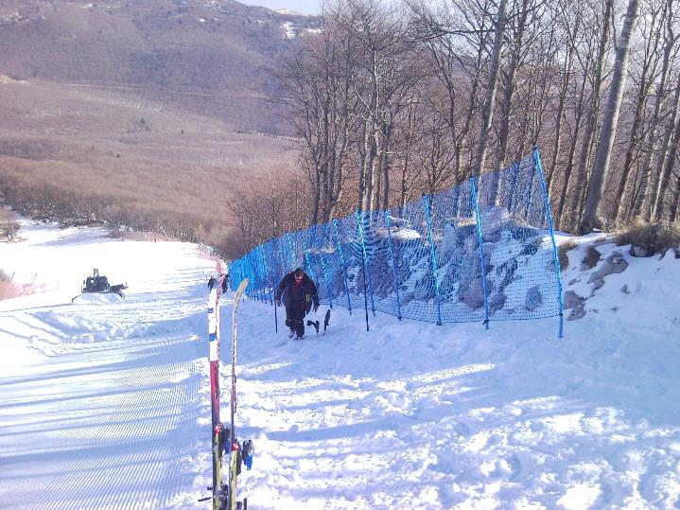
Placing the first fence on the right side

Slide 10
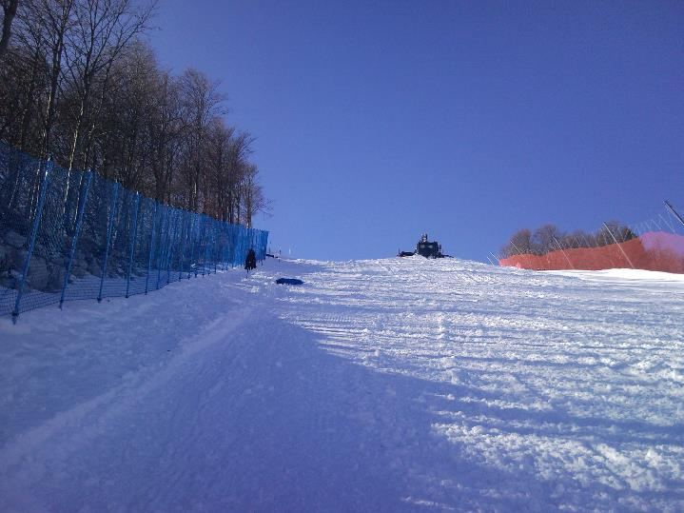
Placing the first fence on the right side

Slide 11
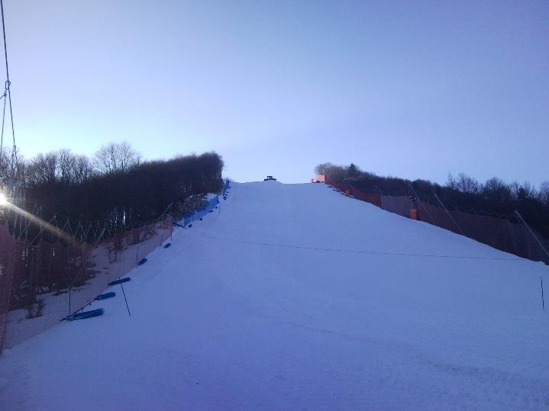
Placing the second fence on the right side

Slide 12
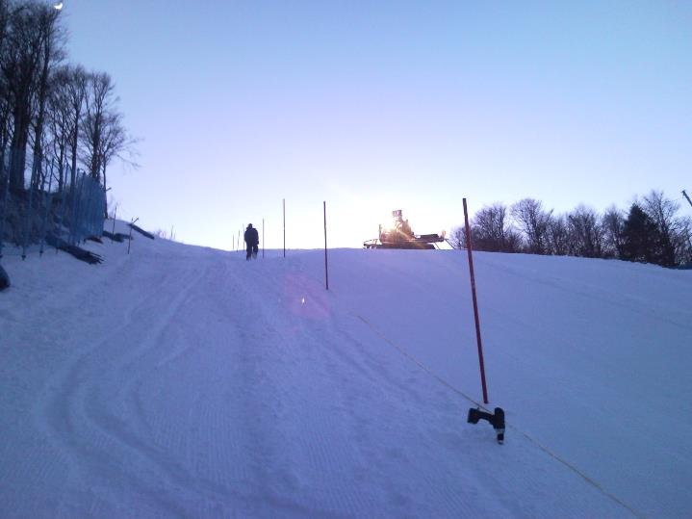
Marking the 8-7-8 placement of the moguls

Slide 13
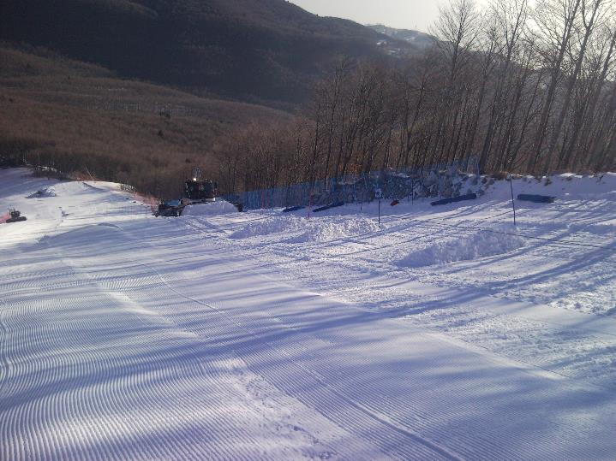
Building the moguls with snow groomer

Slide 14
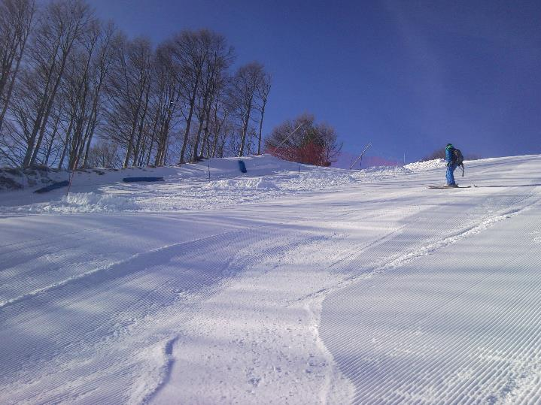
Building the moguls with snow groomer

Slide 15
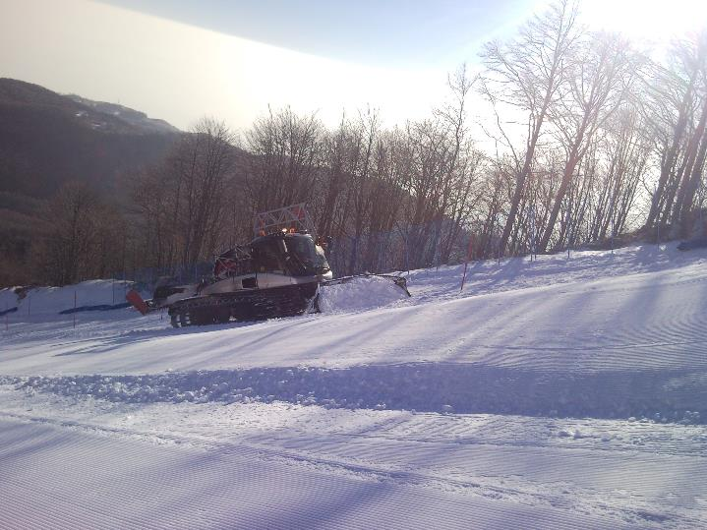
Building the moguls with snow groomer

Slide 16
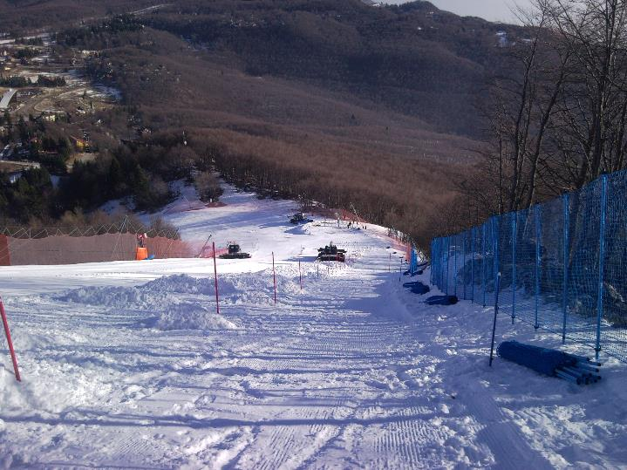
Building the moguls with snow groomer

Slide 17
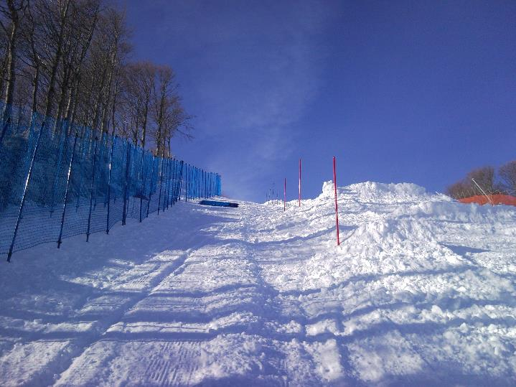
Building the moguls with snow groomer

Slide 18
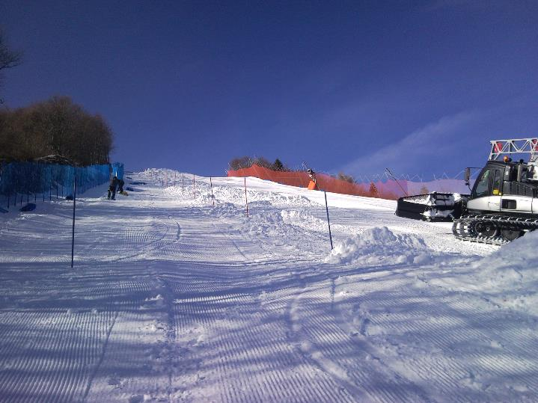
Building the moguls with snow groomer

Slide 19
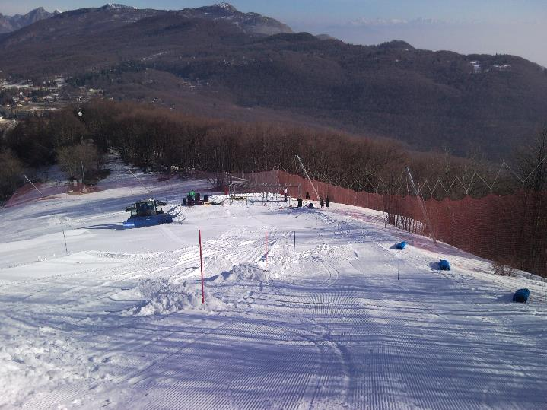
Building the moguls with snow groomer

Slide 20
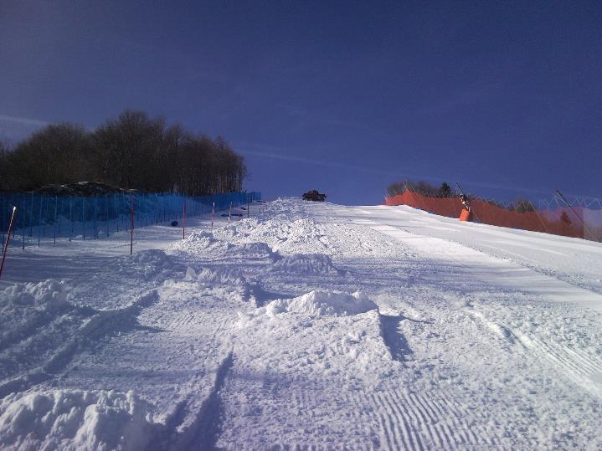
Building the moguls with snow groomer

Slide 21
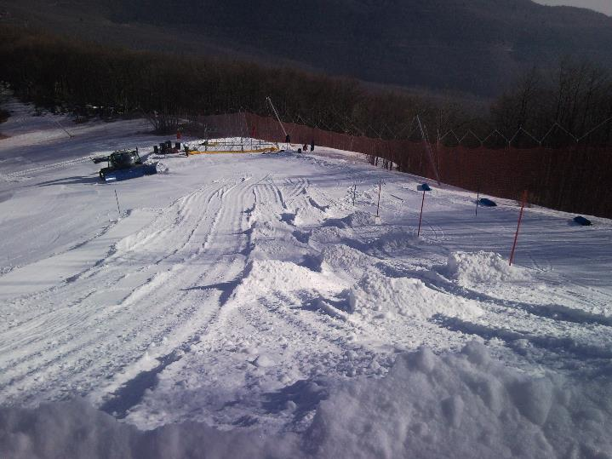
Building the moguls with snow groomer

Slide 22
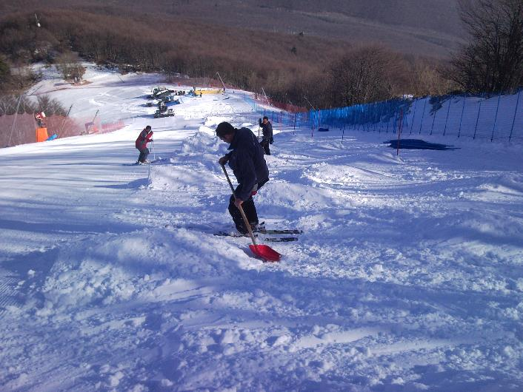
Shaping the moguls with shovels and sideslip

Slide 23
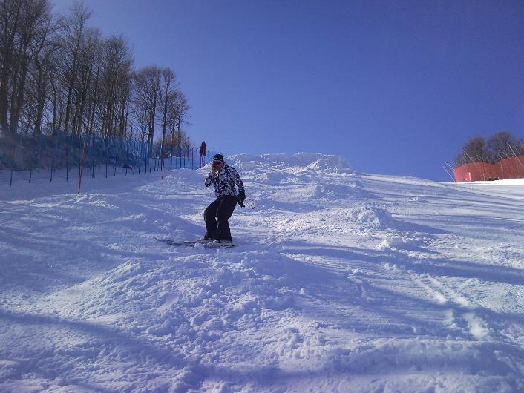
Shaping the moguls with shovels and sideslip

Slide 24
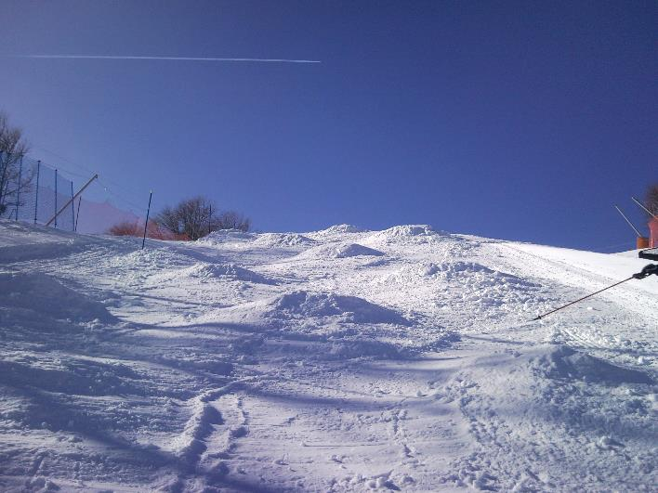
Shaping the moguls with shovels and sideslip

Slide 25
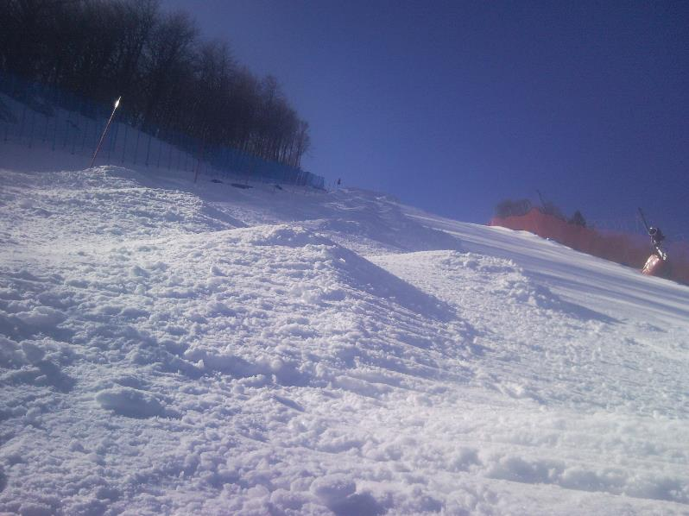
Well shaped mogul

Slide 26

Building the inner right fence

Slide 27
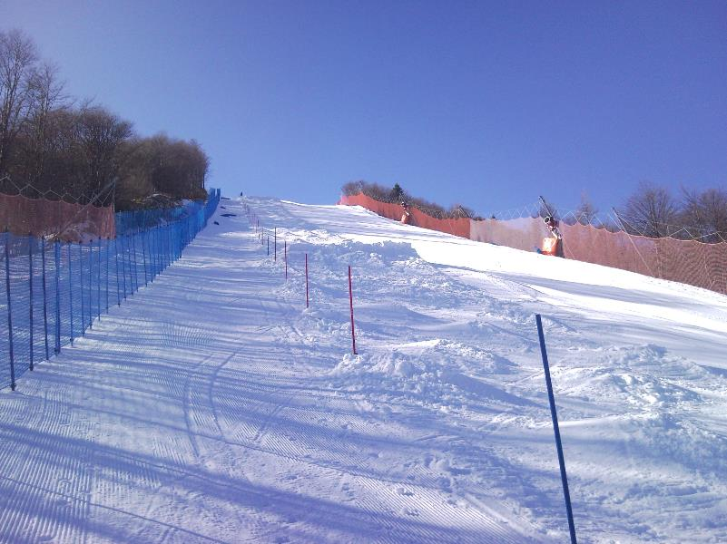
Building the inner right fence

Slide 28
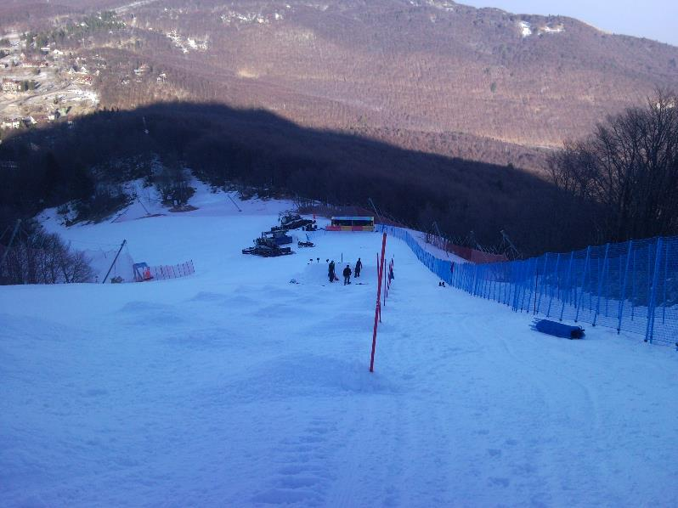
Building the jumps

Slide 29
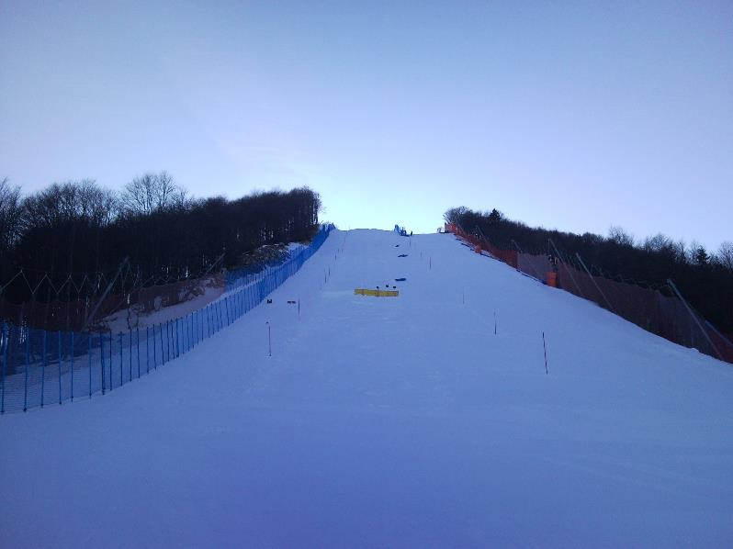
Building the jumps

Slide 30
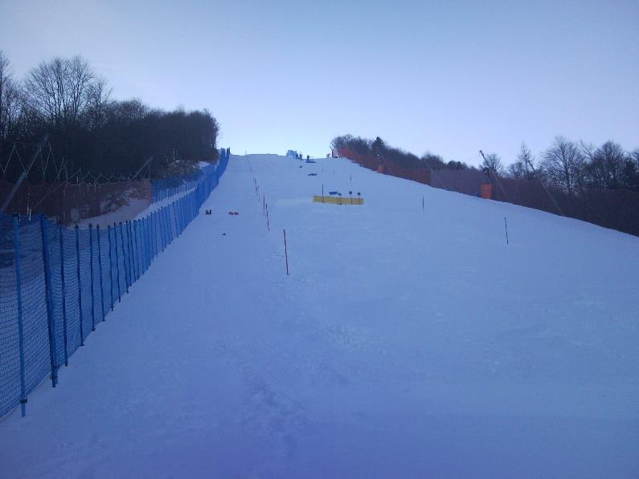
Building the jumps

Slide 31
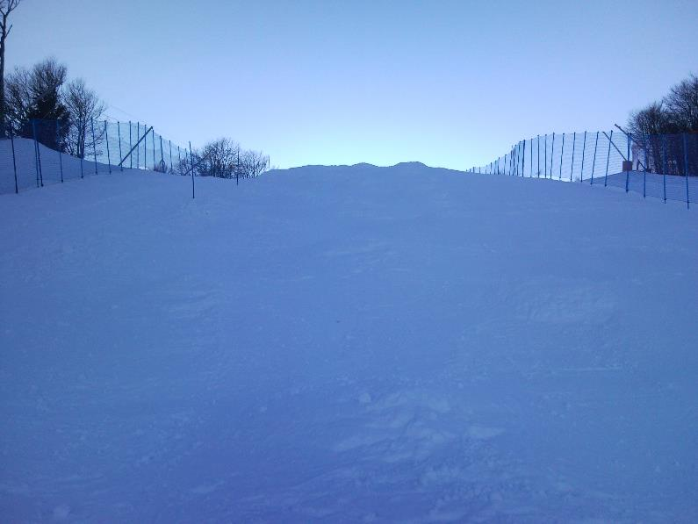
Start fencing

Slide 32
Building the fence on the left side

Slide 33
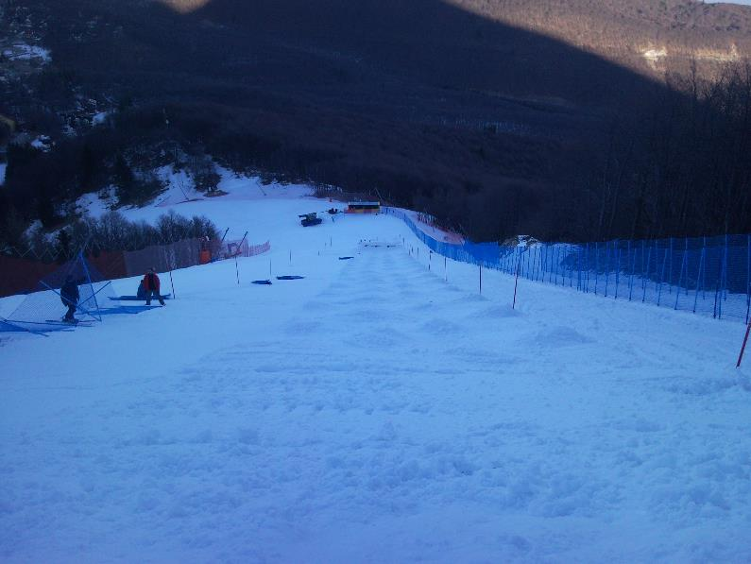
Building the fence on the left side

Slide 34
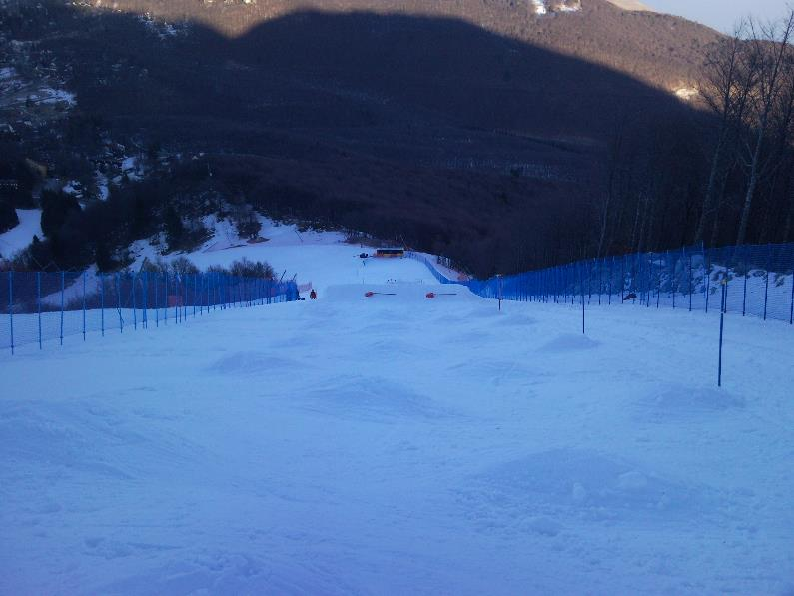
Building the fence on the left side

Slide 35
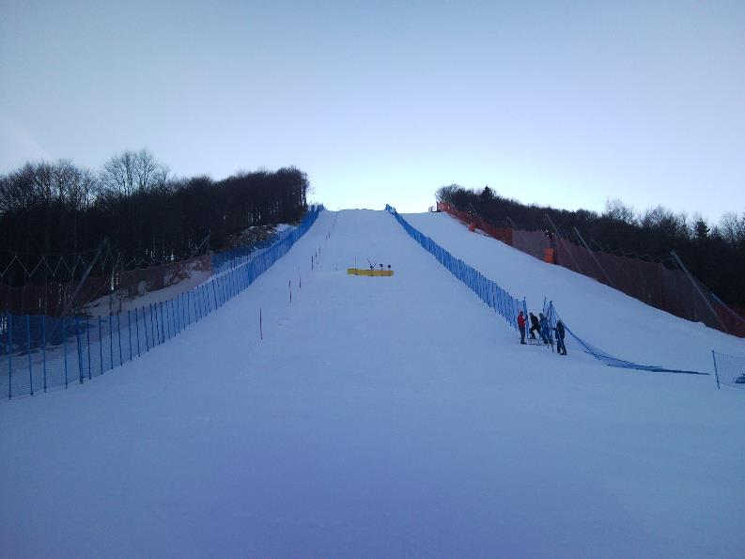
Building the fence on the left side

Slide 36
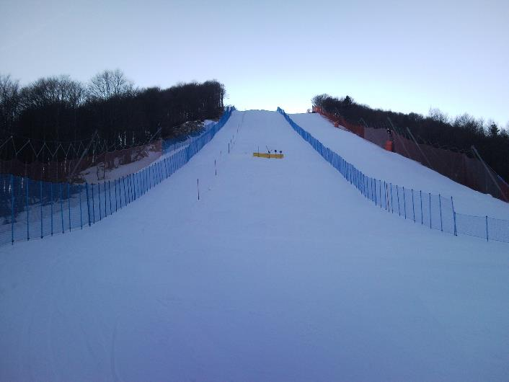
All fencing done (all measurements made from one spot)

Slide 37
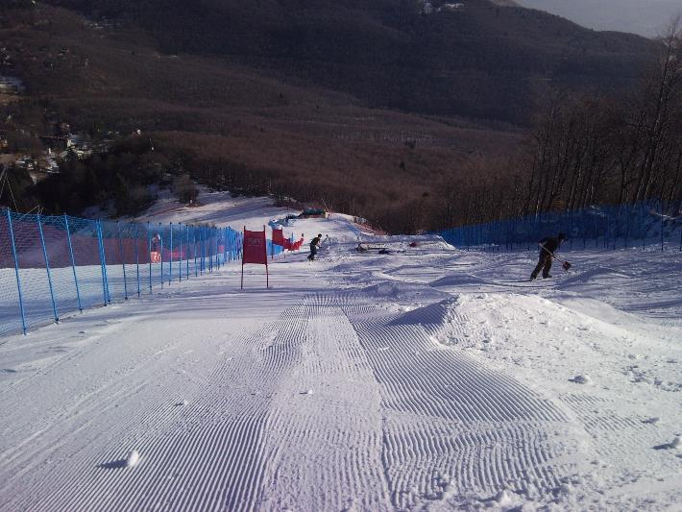
Grooming the left side and placing the gates

Slide 38
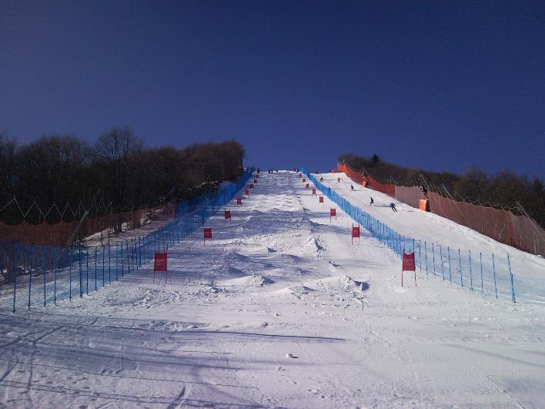
Grooming the right side and placing the gates

Slide 39
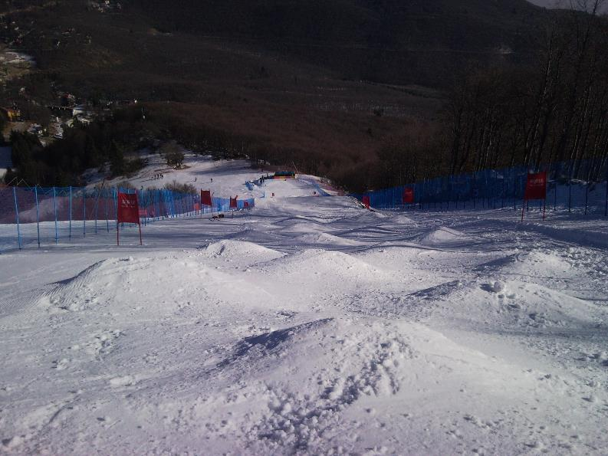
Course prior to first test runs

Slide 40
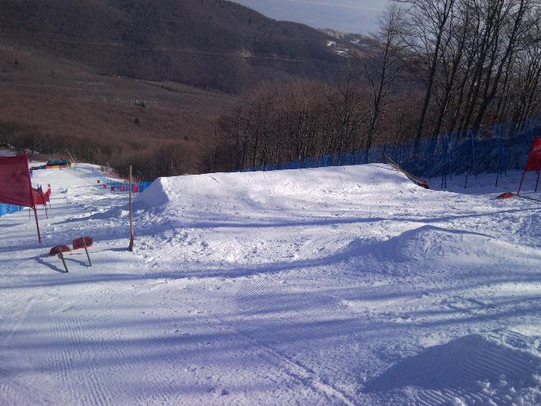
Jump construction before final shaping

Slide 41
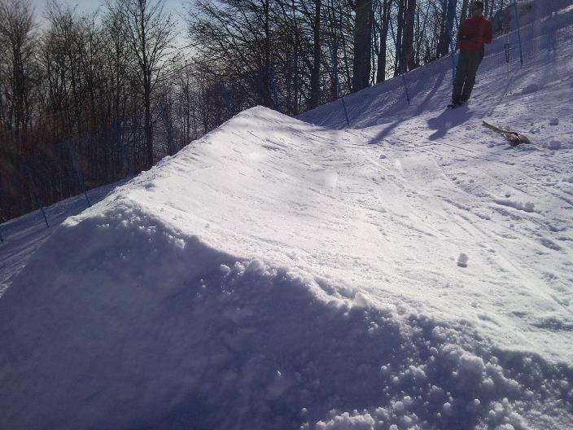
Jump construction before final shaping

Slide 42
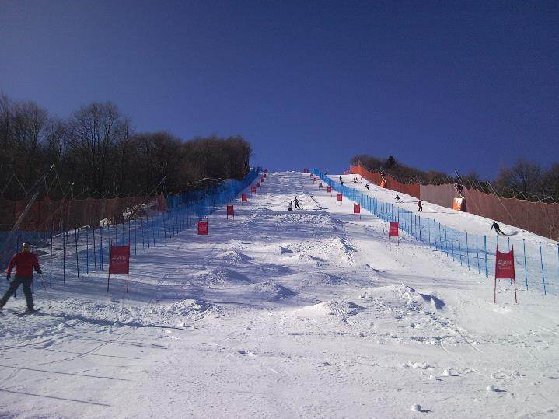
Well constructed course with straight lines

Slide 43
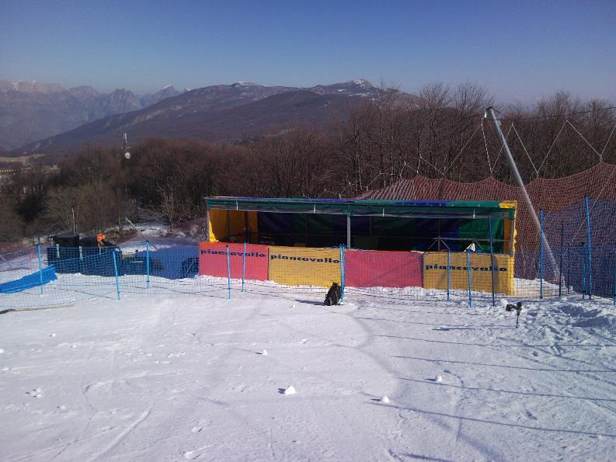
Judges stand

Slide 44
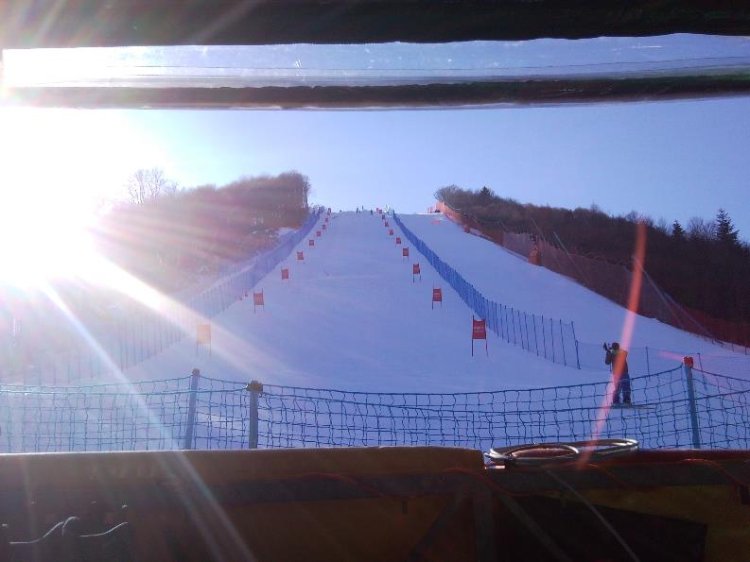
View from the judges’ stand

Slide 45
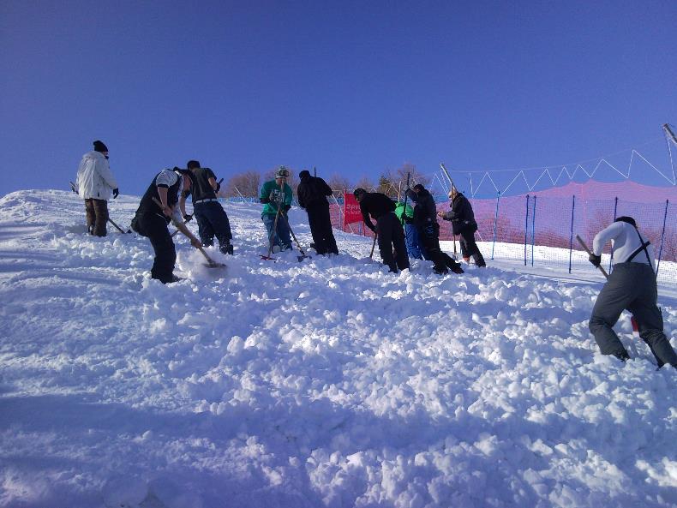
Chopping

Slide 46
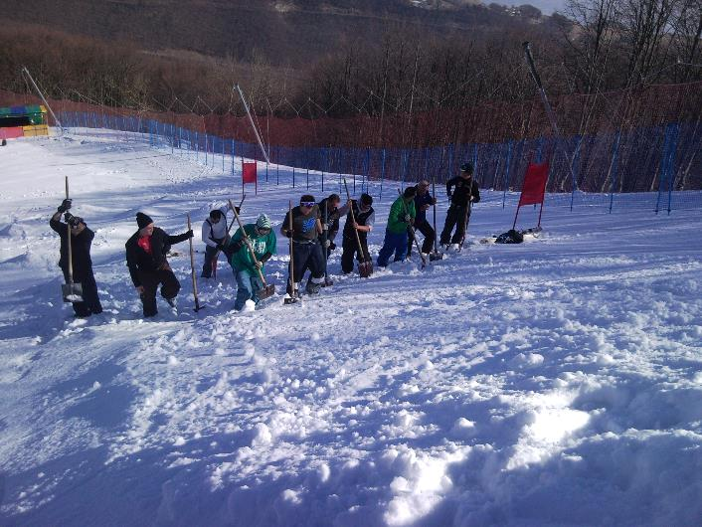
Chopping - every evening and every morning!!!

Slide 47
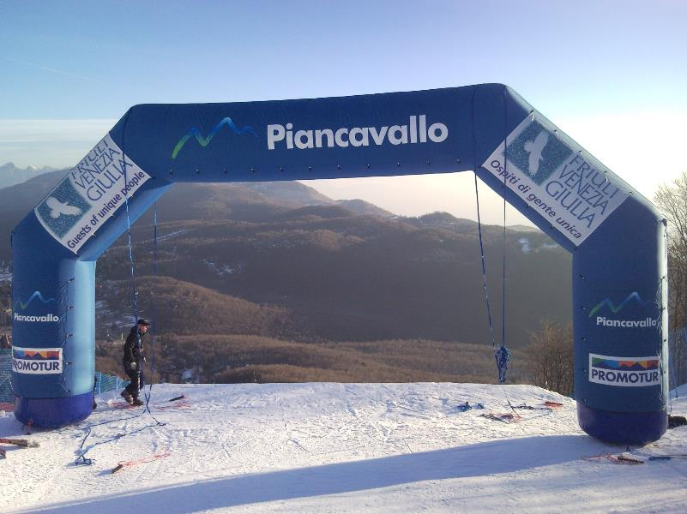
Start arch

Slide 48
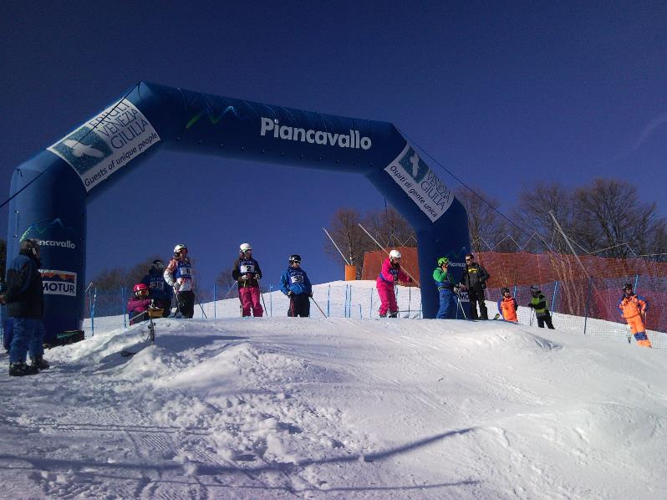
First test runs

Slide 49
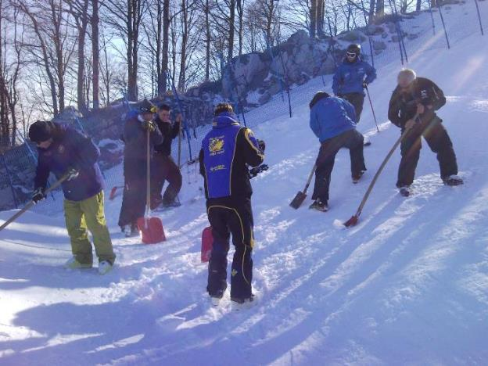
Final shaping of the jumps – coaches chosen from different nations responsible for every jump

Slide 50
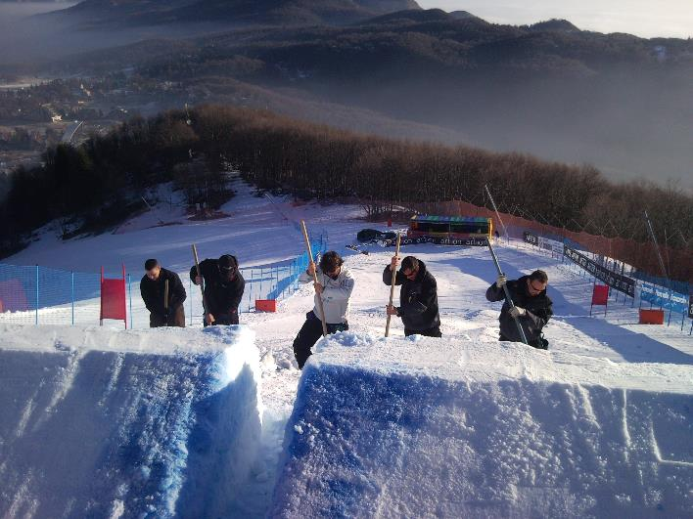
If the weather is warm the jumps are divided just before competition

Slide 51
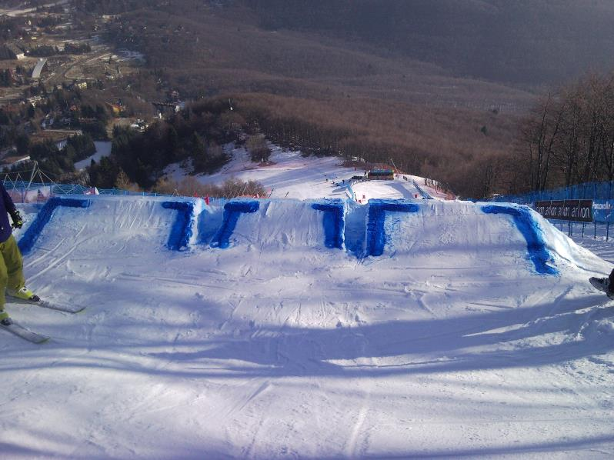
Jump colouring prior training

Slide 52
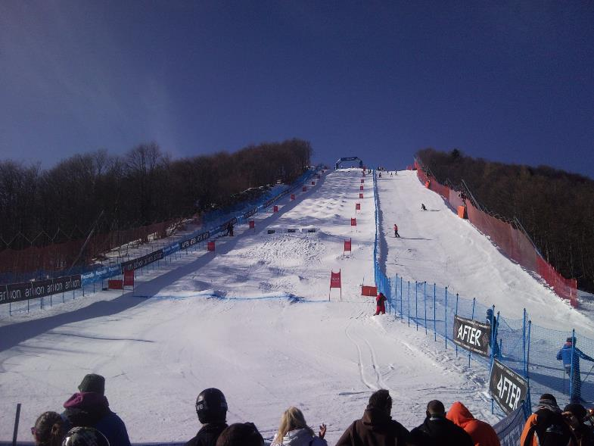
Everything set for the competition

Slide 53
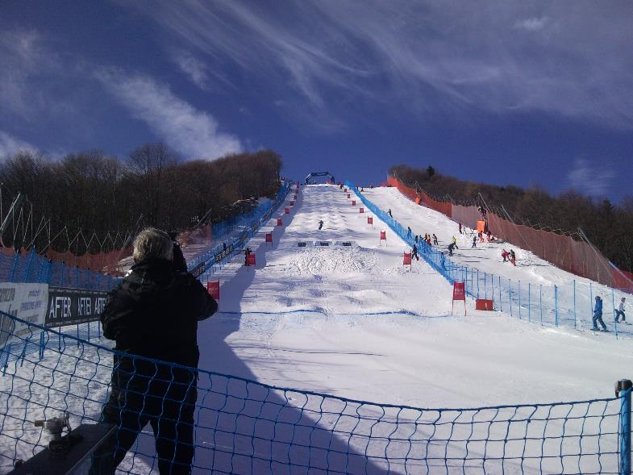
Competition in progress

Slide 54

Happy organizers and TD!

