Slide 1
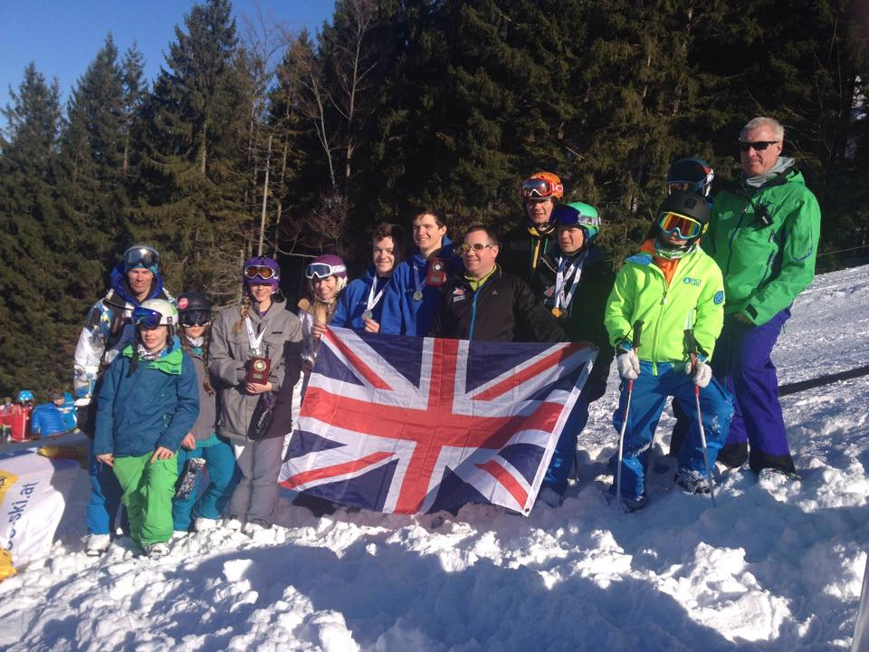
British Moguls Champs athletes Coaches and Head Judge 2015 – from left to right
Martin Carr, James Rose, Abi Richardson, Jodie Grant, Genevieve Justice, Liam Keyes, Sam Houston, Sam Jones, Will Feneley, Sam Burley, Ben Burley, Ian Danby.

Slide 2
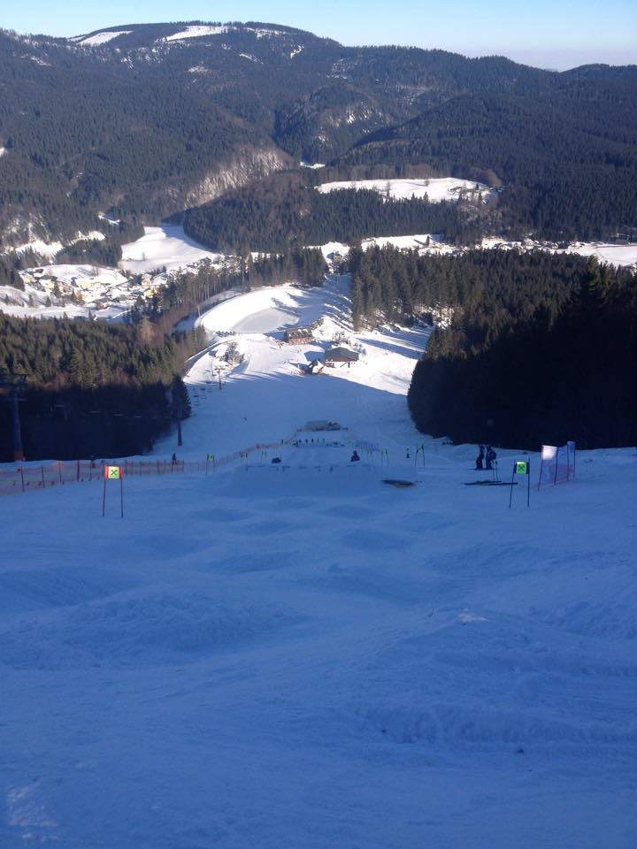
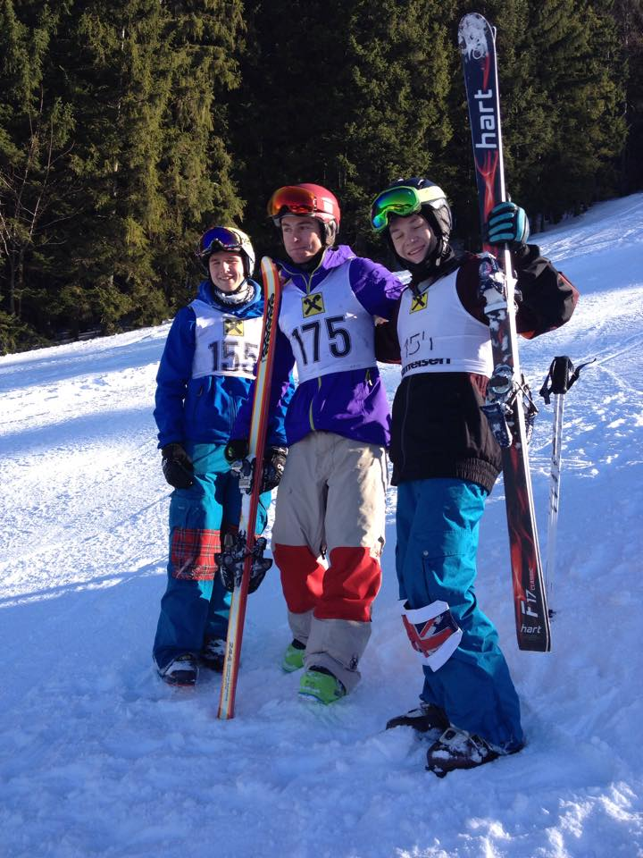
Austrian and British Championships course Lackenhof 2015
FIS Austrian Nattional Champs medalists.
Gold - Thomas Aigner (AUT)
Silver - Sam Houston – (GBR)
Bronze – Liam Keyes – (GBR)

Slide 3
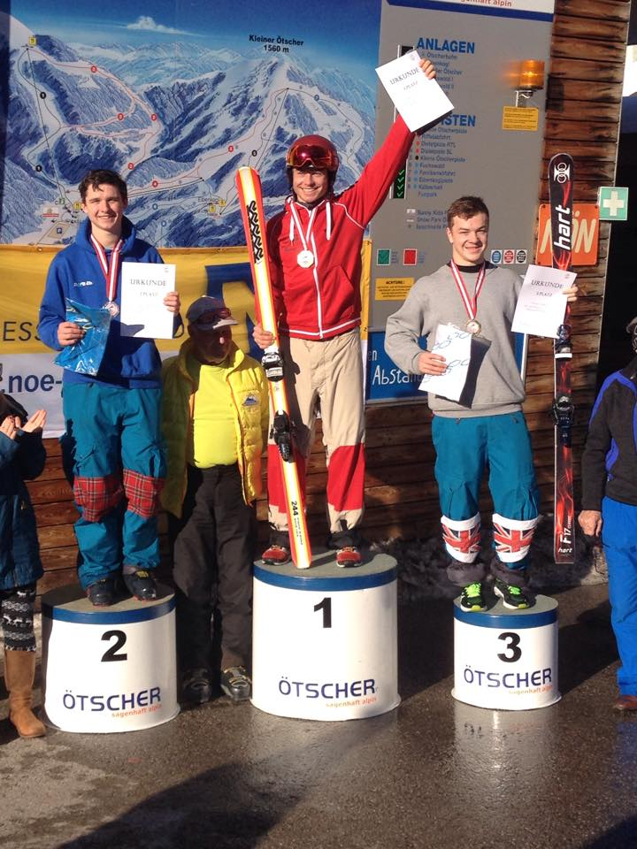
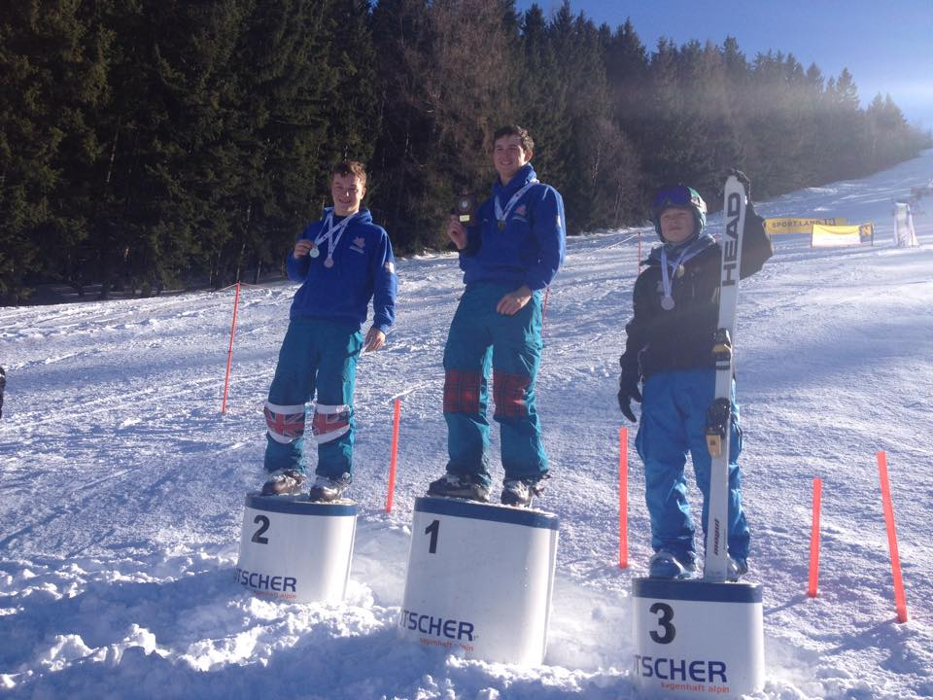
British National Mogul Champs medalists.
Gold - Sam Houston – (GBR)
Silver – Liam Keyes – (GBR)
Bronze – Will Feneley – (GBR)
FIS Austrian National Champs medalists.
Gold - Thomas Aigner (AUT)
Silver - Sam Houston – (GBR)
Bronze – Liam Keyes – (GBR)

Slide 4
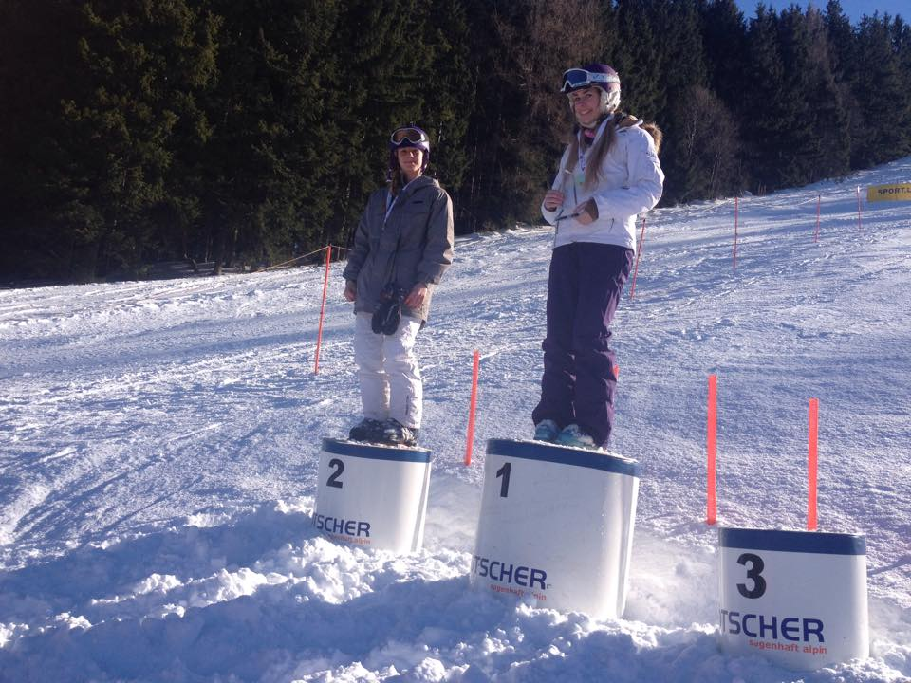
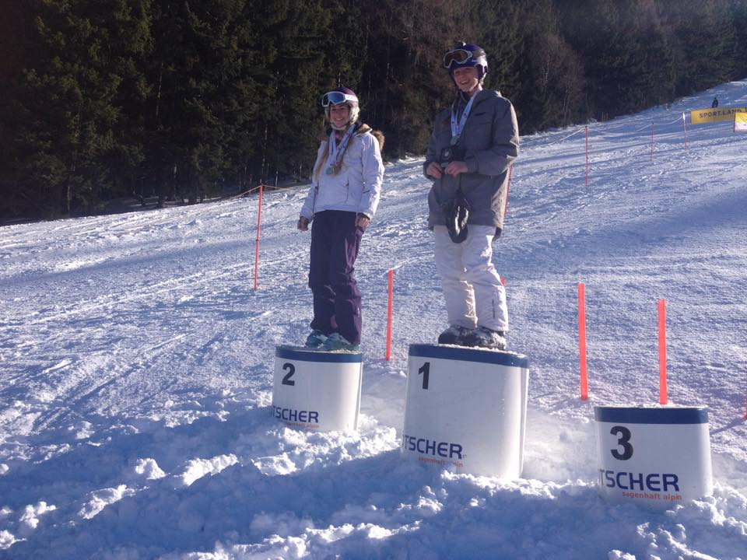
British Champs ladies podium 2015 – Single moguls
Gold Medal – Genevieve Justice
Silver Medal – Jodie Grant
British Champs ladies podium 2015 – Dual moguls
Gold Medal – Jodie Grant
Silver Medal – Genevieve Justice

Slide 5
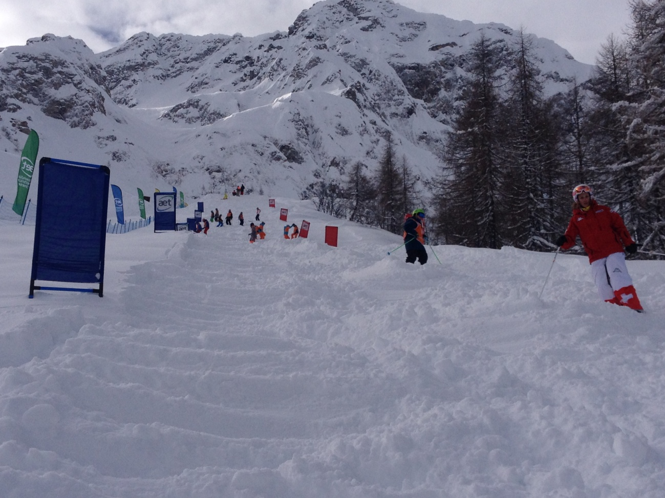
English Champs Course – Airolo Switzerland 2015

Slide 6
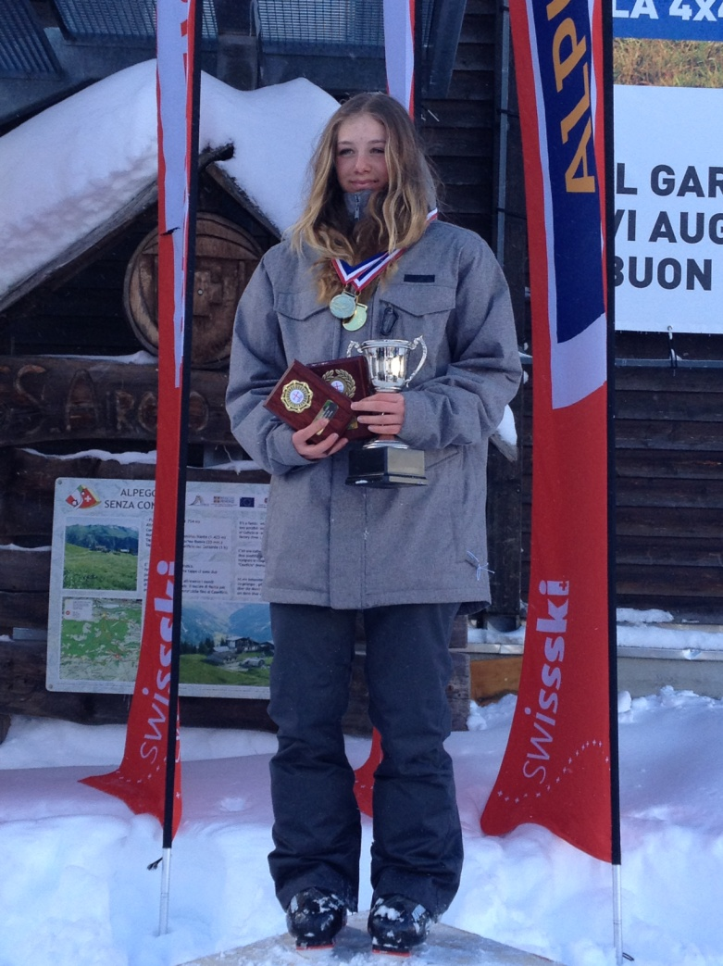
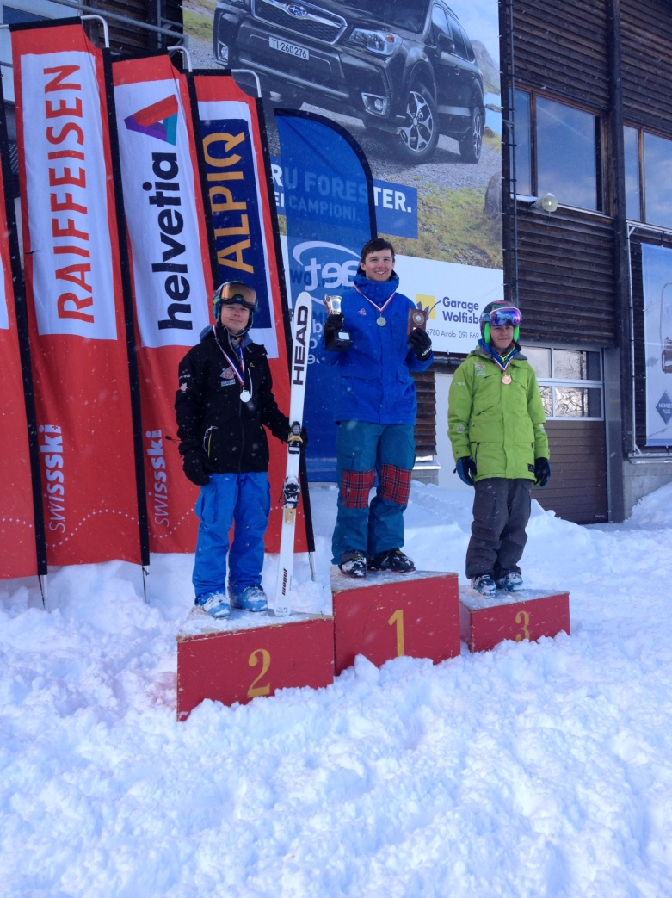
Sam Houston English Single Mogul winner 2015. Will Feneley silver and Thomas Rascagnares Bronze
Jodie Grant English Single and Dual Mogul winner 2015

Slide 7
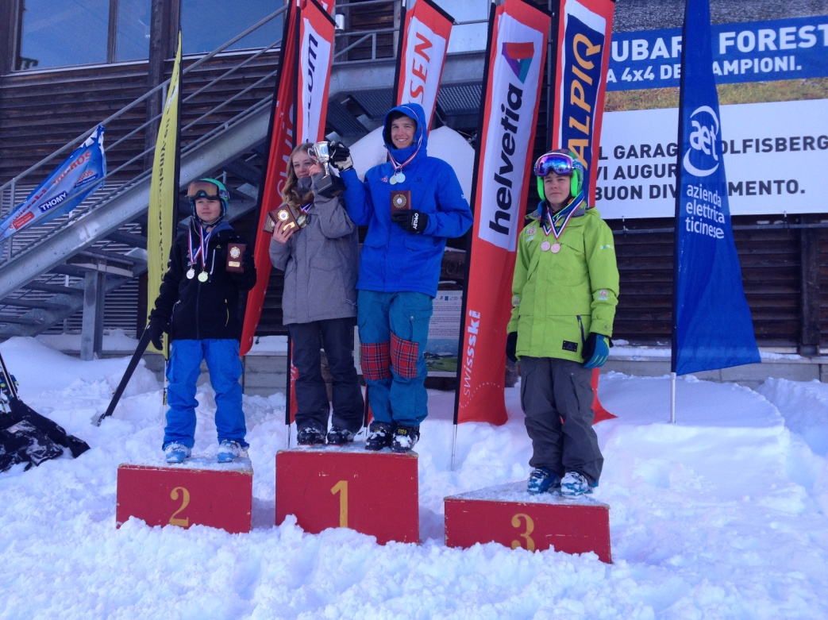
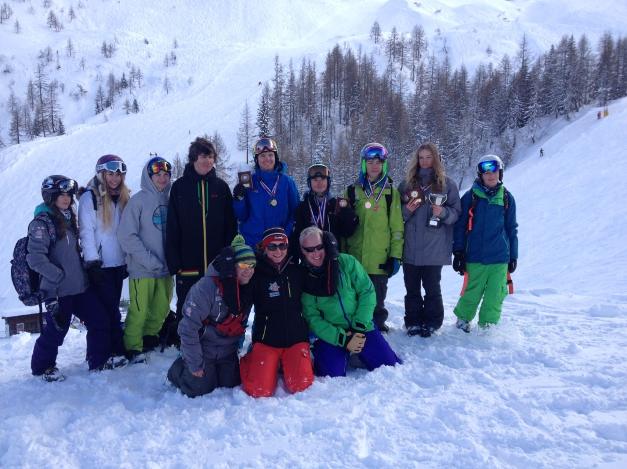
English Single moguls Winners 2015 – Sam Houston and Jodie Grant, Will Feneley Silver and Thomas Rascagnares Bronze
EnglishChamps athletes and Coaches 2015 from left to right.
Abi Richardson, Genevieve Justice, Richard Holt, Sam Jones, Sam Houston, Will Feneley, Thomas Rascagnares, Jodie Grant, James Rose.
Front row, Chris David Ania Wasielewska and Ian Danby.

