Slide 1
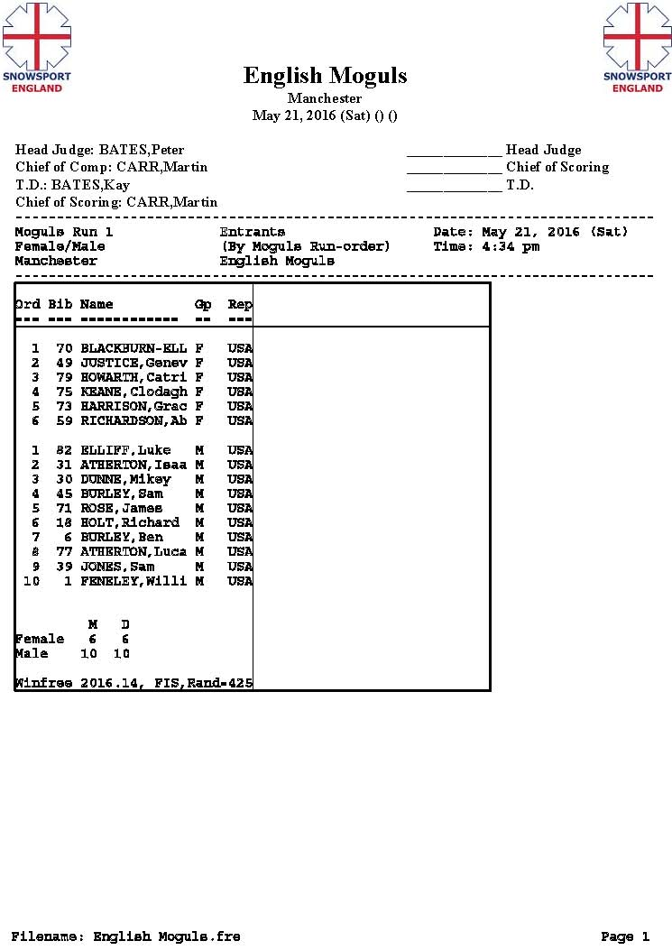

Slide 2
Programme (PLEASE NOTE - ALL TIMES SUBJECT TO CHANGE)
3pm – 4pm - Registration and bib issue
4.30pm – 5.45pm - Open Training
5.45- 6pm Course Preparation
6pm -7.30pm Single Moguls Competition
7.30-8.00pm Single Moguls Finals
8pm -8.30pm Course preparation for Duals
8.30pm-9.30pm Dual Moguls finals
10.pm Prize Giving (or earlier)
Single Format
All athletes will compete in the qualifying round. If there is time, depending on the number of entries, there may be 2 qualification runs with the best counting. The number of athletes that progress to the finals will depend on the number of entries with separate male and female finals.
Duals
The dual moguls will be seeded from the results of the single moguls overall competition. All athletes will have the chance to compete head to head, male and female competitors separately.
Overall English Champion title
The title of English Champion will be awarded to whoever has the highest score irrespective of their age category.
All age groups will compete together. Winners of age categories will only be determined after the competition has been completed and will be taken from the final results list. Anyone not making finals will have the highest result from qualification used to calculate their age category result.

